Slide 1
Library Management System
Faculty Initial – Itn Course – CSE- 311 Section - 3 Group – 3 Name & ID i. Ahmed Faizul Haque Dhrubo ----- 2111026042 ii. Mohammad Akib ---- 2012574642 iii. Mohammad Tarem ---- 2021308642

Slide 2
Title and Content Layout List
Description
ER Diagram
Relational Table
Normalization

Slide 3
Proposal
Introduction: It is a library website where student can read books and rent books for short time .If they didn’t return book on time they will be fined. Here student can issue books by their choice after getting approval then the books will be added. If admin want he can delete books.

Slide 4
Proposal
➔Admin i. Login: Admin must need e unique password & username for login website. If any of them didn’t match admin can not login website. Ii. Sign-up : If admin didn’t open any account he must need to register first then admin can login
➔Student i. Login: Every student must need to Unique Password & username.
ii. Sign-up : If any student didn’t have any account he or she must need to register first. ➔ Books i. Add Books: If student need any books and he/she need then he/she can add them .Admin can also add them.

Slide 5
ii. Delete book: If admin want he/she can delete books but students cannot delete books. iii. Issue-book: Here students can issue book by his/her choice .After admins approval books will be added.
Feedback
Here students can give their opinion and admin can see their name and opinions.
➔Picture Here students and admin can upload their photo.

Slide 6
➔Technology: We used here Php, javascript, html, css , mysql . Css,html,JavaScript for frontend and php,javascript for backend. ➔ Discussion: Write now go to bookshop for buying books kill ours lot of time. By using website we can read books easily. It not only save our money it also save our time and space. We always did not find all books in bookshop but from website we can download all kind of books at free of coast. Here we focused to solve those problems. Here were design this website very easily so anybody can easily use this website.

Slide 7
Strong Entities: Admin , Student , Book , Feedback ,Report, Authentication Admin : Pic , Name , Password , Email , Username(PK) , Phone (FK), St_ID_NO(FK) , b_ID(FK) , r_username(FK) , f_username(FK) Student : ID NO(PK) , Email , Pic , Last Name , First Name , Username , Password , Phone(FK) Book : ID(PK) , Title , Authors , Edition , Department Report : Username(PK) , Return Date , Issue Date , Book ID
Authentication: OTP verification (PK) , Password , Username

Slide 8
Relationship ➔ Student – Book have ( Many to Many) ➔ Student – Authentication(Many to Many) ➔ Admin – Authentication (Many to Many) ➔ Admin – Report (One to Many) ➔ Student – Admin (One to Many) ➔ Admin – Book (One to Many)

Slide 9
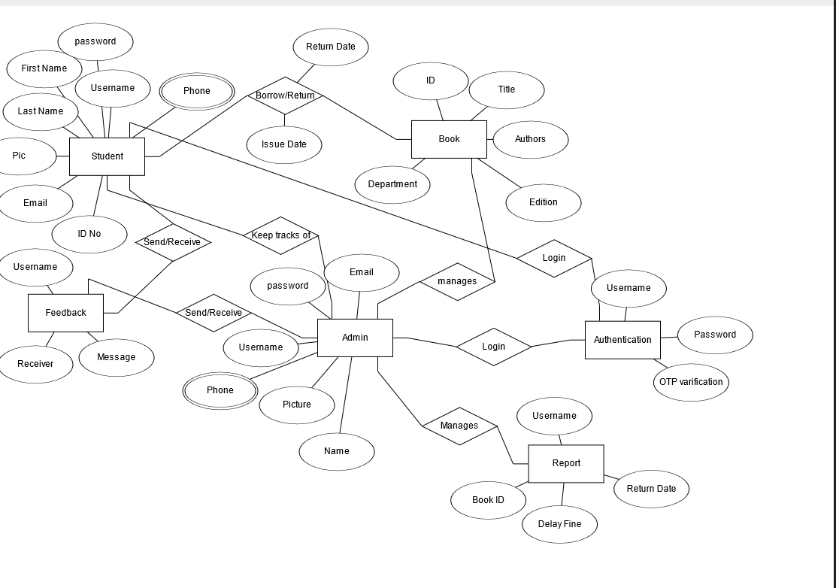
ER-Diagram

Slide 10
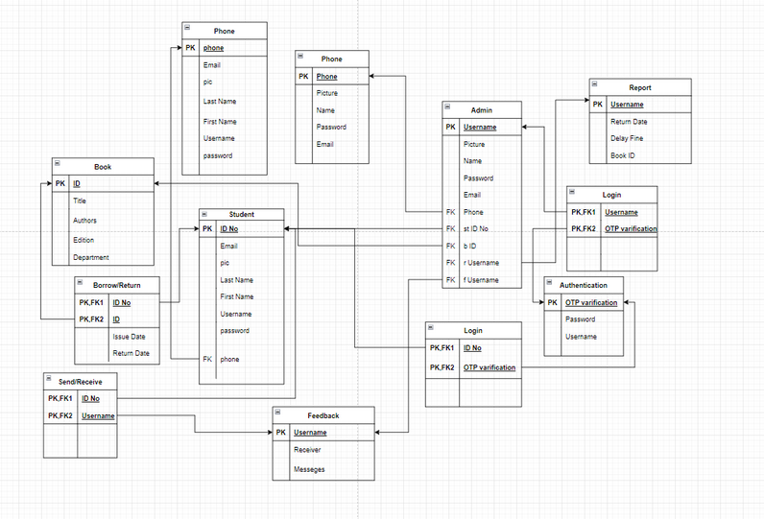
Relational Table

Slide 11
Normalization:
Book: 1-NF:
1.Primary Key 2.Each attribute has same single value attribute 3. Every column has same type domain 4. Row and column order doesn’t matter So, book table is already converted in 1-NF Book : (ID , Title , Authors , Edition , Department)

Slide 12
2-NF:
i. Already in 1–NF ii. Has a prime attribute Book : (ID , Title , Authors , Edition , Department) 3-NF & 4-NF i.No transitive dependency and no multivalued attribute So, Book table is already in 3-NF and 4-NF

Slide 13
Student: 1-NF 1.Primary Key 2.Each attribute has same single value attribute 3. Every column has same type domain 4. Row and column order doesn’t matter Student: (ID No , Email , pic , Last Name , First Name , Username , Password , Phone) 2-NF , 3-NF i. Already in 1-NF , 2-NF ii. Hasn’t any transitive dependency iii. Has 1 prime attribute Student: (ID No , Email , pic , Last Name , First Name , Username , Password , Phone)

Slide 14
4-NF i. Already in 3-NF ii. One Multivalued Attribute
Student: (ID No , Email , pic , Last Name , First Name , Username , Password , Phone, A_phone , S_Phone) Admin: 1-NF 1.Primary Key 2.Each attribute has same single value attribute 3. Every column has same type domain 4. Row and column order doesn’t matter Admin : (Username , Pic , Name , Password , Email , Phone , St_ID_No , BID , r_username , f_username , Phone)

Slide 15
2-NF , 3-NF i. Already in 1-NF , 2-NF ii. Hasn’t any transitive dependency iii. Has 1 prime attribute Admin : (Username , Pic , Name , Password , Email , Phone , St_ID_No , BID , r_username , f_username , Phone)
4-NF i. i. Already in 3-NF ii. One Multivalued Attribute Admin : (Username , Pic , Name , Password , Email , Phone , St_ID_No , BID , r_username , f_username , A_Phone , S_Phone)

Slide 16
Feedback 1-NF: 1.Primary Key 2.Each attribute has same single value attribute 3. Every column has same type domain 4. Row and column order doesn’t matter Feedback : (Username , receiver, messages) 2-NF,3-NF & 4-NF : i. Already in 1-NF , 2-NF,3-NF ii. Hasn’t any transitive dependency iii. Has 1 prime attribute iv. No multivalued attribute
So, Feedback is in 4-NF Feedback : (Username , receiver, messages)

Slide 17
Report: 1-NF: 1.Primary Key 2.Each attribute has same single value attribute 3. Every column has same type domain 4. Row and column order doesn’t matter Report : (Username , return date , delay fine , book id)
2-NF,3-NF & 4-NF : i. Already in 1-NF , 2-NF,3-NF ii. Hasn’t any transitive dependency iii. Has 1 prime attribute iv. No multivalued attribute
So, Report is in 4-NF
Report : (Username , return date , delay fine , book id)

Slide 18
Authentication: 1-NF: 1.Primary Key 2.Each attribute has same single value attribute 3. Every column has same type domain 4. Row and column order doesn’t matter Authentication: (OTP varification , password , username) 2-NF,3-NF & 4-NF : i. Already in 1-NF , 2-NF,3-NF ii. Hasn’t any transitive dependency iii. Has 1 prime attribute iv. No multivalued attribute
So, Authentication is in 4-NF
Authentication: (OTP varification , password , username)

